Slide 1

BEST STREAMING SERVICE
BY
K.RAJESHWARI

Slide 2
PART -1
THE BEST STREAMING SERVICE PREDICTION USING SUPERVISED LEARNING

Slide 3
STREAMING SERVICE
Streaming services started as an add-on to DVD and digital download offerings with a trickle of second-run movies and TV shows.
They were supplements to the programs you watched on their first (and second) runs on cable TV.
An online provider of entertainment (music, movies, etc.) that delivers the content via an Internet connection to the subscriber's computer, TV or mobile device. Netflix, Amazon Prime Video, Hulu, Spotify and Apple Music are high-profile examples.

Slide 4
PROJECT DESCRIPTION
The types of streaming services like Netflix, Hulu, Prime Video, Disney+ and IMDb ratings are responsible for predicting the best streaming service.
The best streaming service can be predicted using linear regression.
Our project uses python for best streaming service prediction.
This report aims to answer this question by using visualizations and drive insights out of the data
The data sets are taken from the website KAGGLE – BEST STREAMING SERVICE.

Slide 5
MODULES USED
Preprocessing
Data Analytics Technique
Visualisation

Slide 6
DATA PREPROCESSING
The data is in a wide format and consists of a couple of unnecessary columns. We'll remove the unnecessary columns and change the data format from wide to long.
We have used DATA CLEANING in order to remove the missing values and obtain a meaningful data.
For our project we are replacing the fame scores with the median value of our attribute.

Slide 7
DATA ANALYTICS TECHNIQUE
A linear regression model is a linear approximation of a causal relationship between two or more variables.
Regressions models are highly valuable, as they are one of the most common ways to make inferences and predictions.
For our project we are using LINEAR REGRESSION model for predictions.

Slide 8
VISUALISATON
In order to understand data, it is often useful to visualize it. Normally in Big Data applications, the interest relies in finding insight rather than just making beautiful plots.
In our project we are using Scatter Plot based on Rotten Tomatoes and Correlation Plot based on each attributes.
The predicted ratings are represented in scatter plot.

Slide 9
PYTHON CODE
IMPORT LIBRARIES:
import numpy as np
import pandas as pd
import seaborn as sns
import matplotlib.pyplot as plt
%matplotlib inline

Slide 10
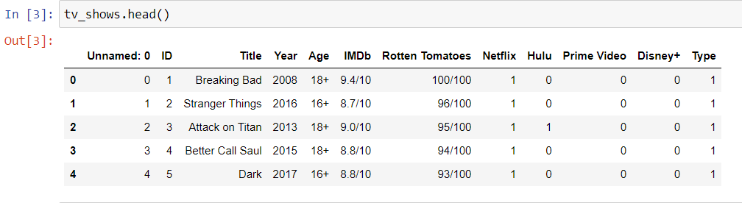
READ DATA AND PRINT HEAD :
tv_shows=pd.read_csv('tv_shows.csv')
tv_shows.head()
OUTPUT:

Slide 11
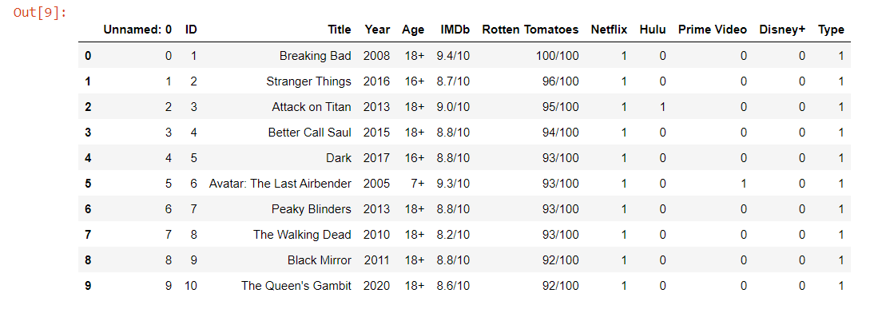
REPLACE THE TYPE WITH THE MEDIAN VALUE:
tv_shows['Title'].fillna(‘Type',inplace=True)
tv_shows.head(10)
OUTPUT:

Slide 12
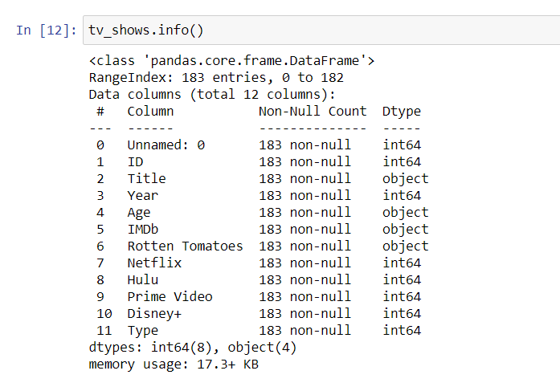
INFORMATION ABOUT DATASET :
tv_shows.info()
OUTPUT:

Slide 13
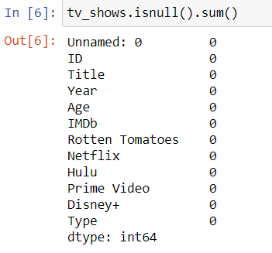
CHECK MISSING VALUES IN DATASET:
tv_shows.isnull().sum()
OUTPUT:

Slide 14
LINEAR REGRESSION:
from sklearn.neighbors import KNeighborsRegressor
knr=KNeighborsRegressor(20)
from sklearn.model_selection import train_test_split
X_train, X_test, y_train, y_test = train_test_split(X, y, test_size=0.2,
random_state=8)
from sklearn.ensemble import RandomForestRegressor
from sklearn.metrics import accuracy_score
rf_random = RandomForestRegressor()
y_test

Slide 15
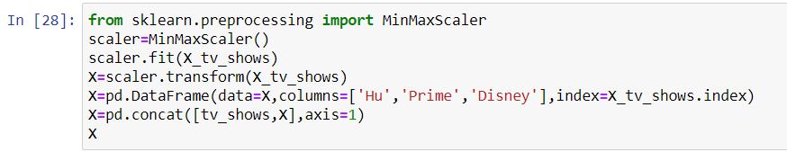
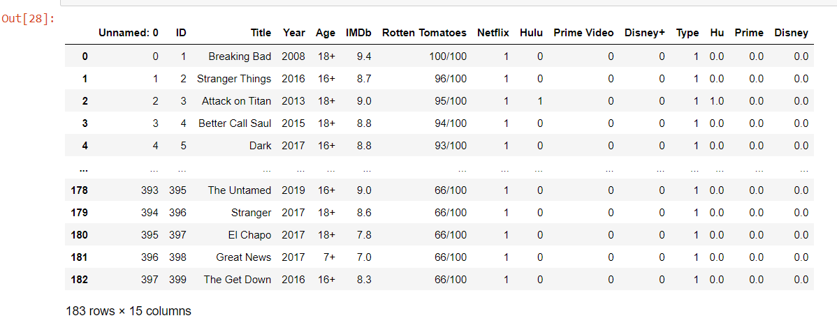
Data processing…

Slide 16
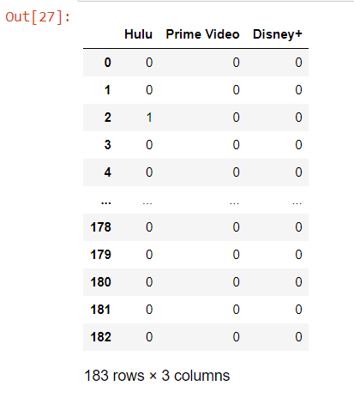
FILTER BASED ON SERVICES:
X_tv_shows=tv_shows[[‘Hulu’,’Prime Video’,’Disney+’]]
y=tv_shows[‘IMDb’]
X_tv_shows
OUTPUT:

Slide 17
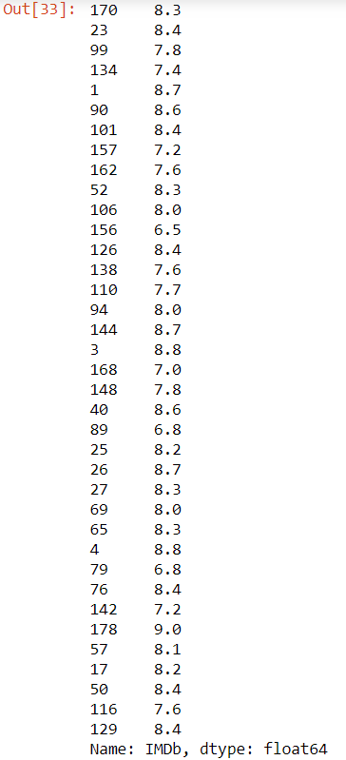
DROP THE COLUMNS : OUTPUT:
X.drop('Year',axis=1,inplace=True)
X.drop('Age',axis=1,inplace=True)
X.drop('Type',axis=1,inplace=True)
X.drop('Title',axis=1,inplace=True)

Slide 18
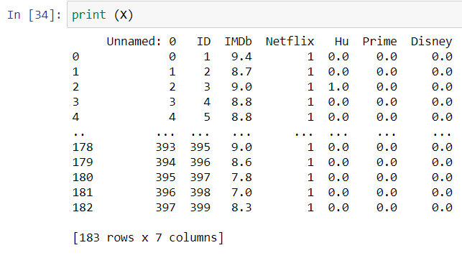
PRINTING THE VALUES:
print (X)
OUTPUT:

Slide 19
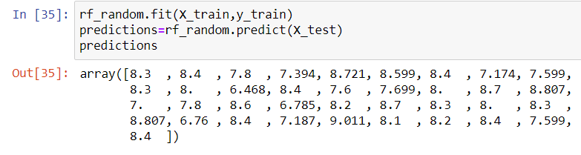
TRAINING AND TESTING DATA :
rf_random.fit(X_train,y_train)
predictions=rf_random.predict(X_test)
predictions
OUTPUT:

Slide 20
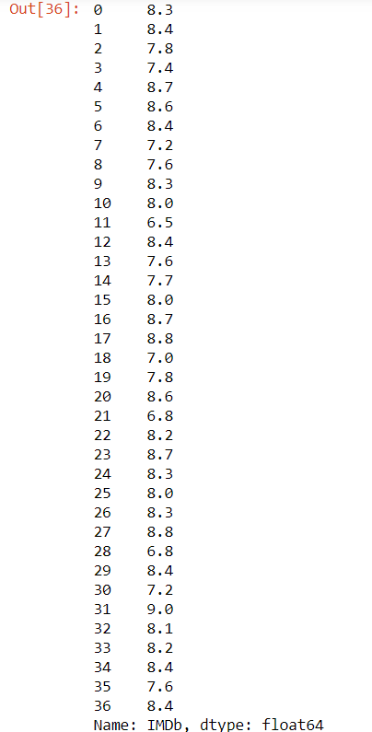
RESET INDEX:
y_test.reset_index(drop=True,inplace=True)
y_test
OUTPUT:

Slide 21
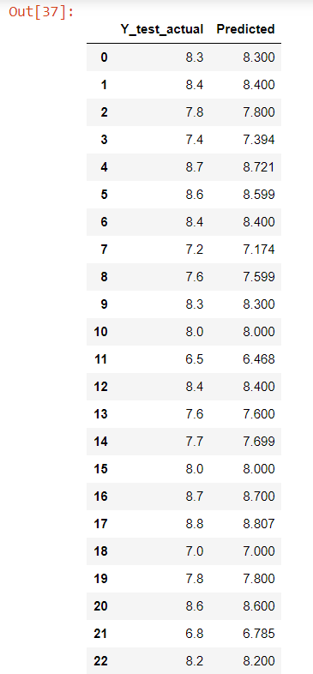
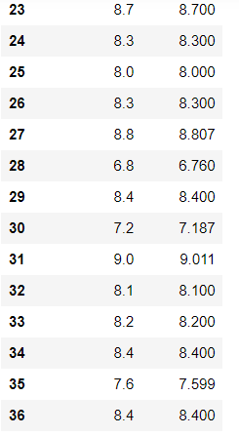
PREDICTING THE IMDb:
results=pd.DataFrame(columns=[‘Y_test_actual’,’Predicted’])
results[‘Y_test_actual’]=y_test
results[‘Predicted’]=predictions OUTPUT:
results

Slide 22
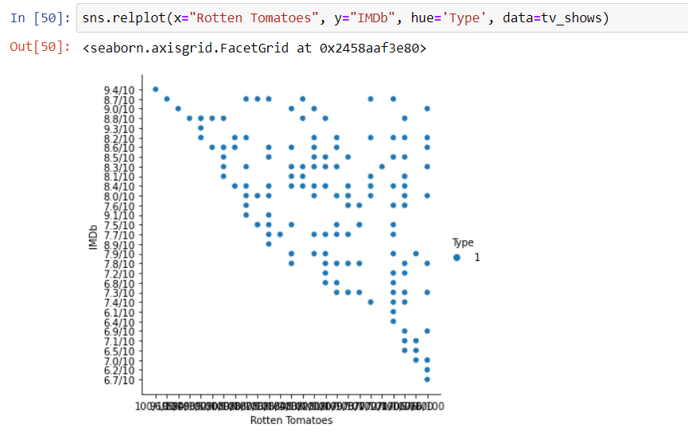
SCATTER PLOT BASED ON ROTTEN TOMATOES :
sns.relplot(x="Rotten Tomatoes", y="IMDb", hue='Type', data=tv_shows)
OUTPUT:

Slide 23
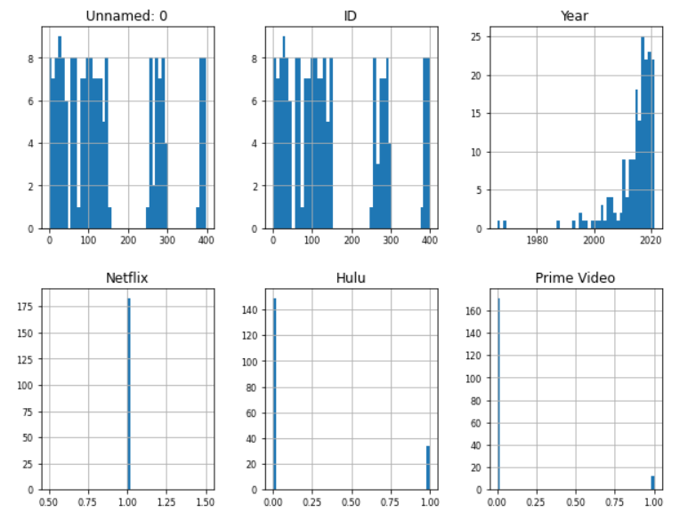
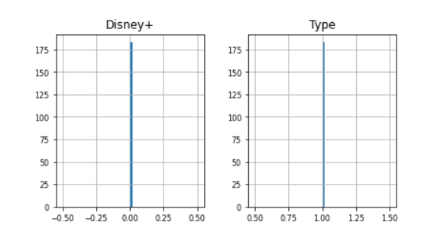
CORRELATION PLOT :
tv_shows.hist(figsize=(10, 12), bins=50, xlabelsize=8, ylabelsize=8);
OUTPUT:

Slide 24
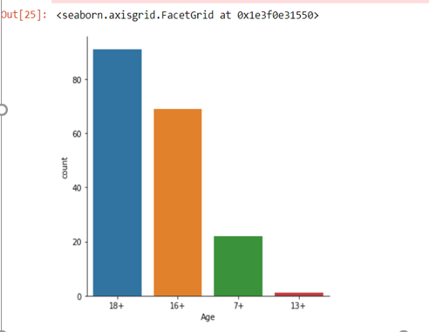
FACTOR PLOT :
sns.factorplot("Age",data=tv_shows,kind="count")
OUTPUT:

Slide 25
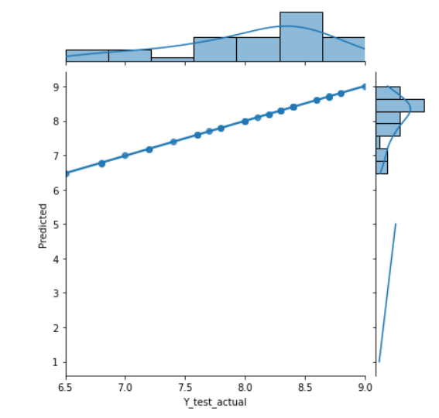
SCATTER PLOT :
sns.jointplot(x=‘Y_test_actual’, y=‘Predicted’, data=results.kind=“reg”)
Plt.plot([1,5],[1,5])
Plt.show()
OUTPUT:

Slide 26
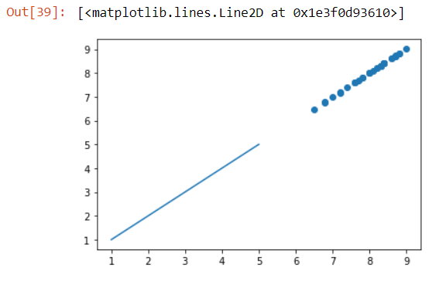
SCATTER PLOT:
plt.scatter(y_test,predictions)
plt.plot([1,5],[1,5])
OUTPUT:

